Slide 1
CSC 3210 Computer Organization and Programming
Lab Work 11
Dr. Zulkar Nine
mnine@gsu.edu
Georgia State University
Spring 2022

Slide 2
Learning Objective
Logical Instructions, and If & While statements

Slide 3
Disclaimer
The process shown in these slides might not work in every single computer due to Operating system version, Microsoft Visual Studio versions and everything.
If you find any unusual error, you can inform the instructor.
Instructor will help you resolve the issue.

Slide 4
Attendance!

Slide 5
Lab Work 11 Instructions
Lab 11 : Logical Instructions, and If & While statements

Slide 6
Plan early …
You have one week time to submit the lab
Start early
If you have issues
Email TA or instructor
Stop by during office hours
Start working at the last moment is not a good idea.
AppendixA shows how to check memory data and Appendix B shows how to create a new project.

Slide 7
Problems in this lab
You might see similar questions in the quizzes and exam.
During the exam you might need solve similar problems without visual studio.

Slide 8
Compound Expression with AND (Example1)
When implementing the logical AND operator, consider that HLLs use short-circuit evaluation
In the following example, if the first expression is false, the second expression is skipped:
if (al <= bl) AND (bl >= cl)
X = 1;
else
Y = 1

Slide 9
Compound Expression with AND (Example1)
When implementing the logical AND operator, consider that HLLs use short-circuit evaluation
In the following example, if the first expression is false, the second expression is skipped:
cmp al,bl ; first expression...
jbe L1
jmp Else_block
L1:
cmp bl,cl ; second expression...
jae If_block
jmp Else_block
If_block: ; both are true
mov X,1 ; set X to 1
jmp next
Else_block:
mov Y, 1
Next:
if (al <= bl) AND (bl >= cl)
X = 1;
else
Y = 1

Slide 10
WHILE Loops
A WHILE loop tests a condition first before performing a block of statements.
As long as the loop condition remains true, the statements are repeated.
When implementing this structure in assembly language,
it is convenient to reverse the loop condition
and jump to endwhile if a condition becomes true

Slide 11
WHILE Loops: Example1
mov eax,val1 ; copy variable to EAX?
beginwhile:
cmp eax,val2 ; if not (val1 < val2)
jge endwhile ; exit the loop
inc eax ; val1++;
dec val2 ; val2--;
jmp beginwhile ; repeat the loop
endwhile:
mov val1,eax ; save new value for val1
Reverse The loop Condition
G and L
Notes:
Verify this: jnl and jnle
Tu, Oct, 17, 4pm

Slide 12
WHILE Loops: Example1
While ( (val1 != val2) AND (val1 > 0){
Val3++
}
G and L
Notes:
Verify this: jnl and jnle
Tu, Oct, 17, 4pm

Slide 13
WHILE Loops: Example1
While ( (val1 != val2) AND (val1 > 0){
Val3++
}
mov eax,val1 ; copy variable to EAX?
beginwhile:
cmp eax,val2 ; if not (val1 == val2)
je endwhile
cmp val1, 0
jbe endwhile
inc val3 ; val3++;
jmp beginwhile ; repeat the loop
endwhile:
G and L
Notes:
Verify this: jnl and jnle
Tu, Oct, 17, 4pm

Slide 14
IF and While Statements
Example: Write and run a program to translate the following while and if statements:

Slide 15
WHILE Loops:
IF statement Nested in a Loop

Slide 16
😳
40/4 = 10
What will be the value of SUM?
Loop
IF

Slide 17
Shift and Rotate Instructions
Example: Write and run a program to find the values of each destination operand:
mov al,0D4h
shr al,1 ; a.
mov al,0D4h
sar al,1 ; b.
mov al,0D4h
sar al,4 ; c.
mov al,0D4h
rol al,1 ; d.
mov al,0D4h
ror al,3 ; e

Slide 18
Shift and Rotate: Instructions Shifting Multiple Doublewords
Example: Write and run a program to find the values of each destination operand:
.data
ArraySize = 3
array DWORD ArraySize DUP(99999999h) ; 1001 1001...
.code
mov esi,0
shr array[esi + 8],1 ; high dword
rcr array[esi + 4],1 ; middle dword, include Carry
rcr array[esi],1 ; low dword, include Carry
Use the memory window to verify the result

Slide 19
Lab 11
Submission

Slide 20
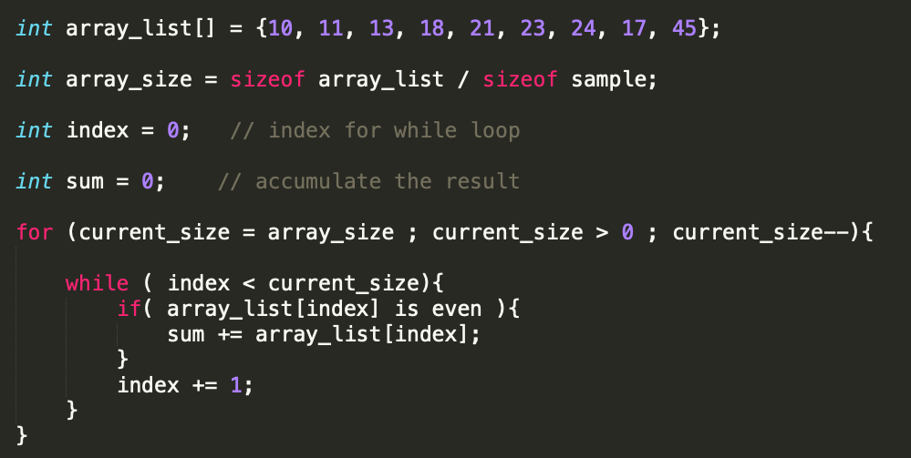
Submission (1)
Convert the following pseudo code into assembly code.
Store the result in the variable – sum.

Slide 21
Submission Instruction
Submit the screenshot of your code.
Debug your code until you reach INVOKE ExitProcess, 0
Take a screenshot of the watch window showing variable sum.
Submit the screenshot.
Also, Rename the asm file using your last name as Lastname.asm
Submit the ASM file as well.

Slide 22
Appendix A
Checking Memory Data

Slide 23
Checking Memory Data
Use Memory window to verify the values of memory locations.
To activate Memory window, run the debugger, go to debug menu and click on windows, open it, go to Memory then choose Memory1.
When you run your program and step over every line you will see the changed values marked with red color.
You Must be in the Debugging Mode to see the memory or the register window

Slide 24
Checking Memory Data
To activate Memory window,
if you want to see the location of your variable in the memory,
Memory window search box (on the top of the memory window, Address:)
write & follow it with the variable name: example: &myVall.
This will take you to the memory locations of your program (.data section).

Slide 25
Checking Memory Data
To activate Memory window,
You can right-click inside the memory window
You will see Popup menu for the debugger’s memory window
You can choose how you want to group your bytes: by 1,2,4, or by 8
You can also presents data in hexadecimal, signed, or unsigned display

Slide 26
Appendix B
Create a Project

Slide 27
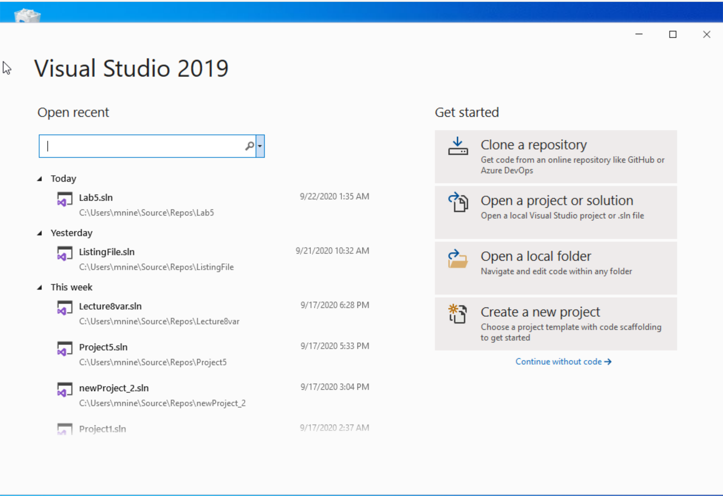


Step 1: Create a project (1)
Start Visual Studio
Click Create a new Project

Slide 28
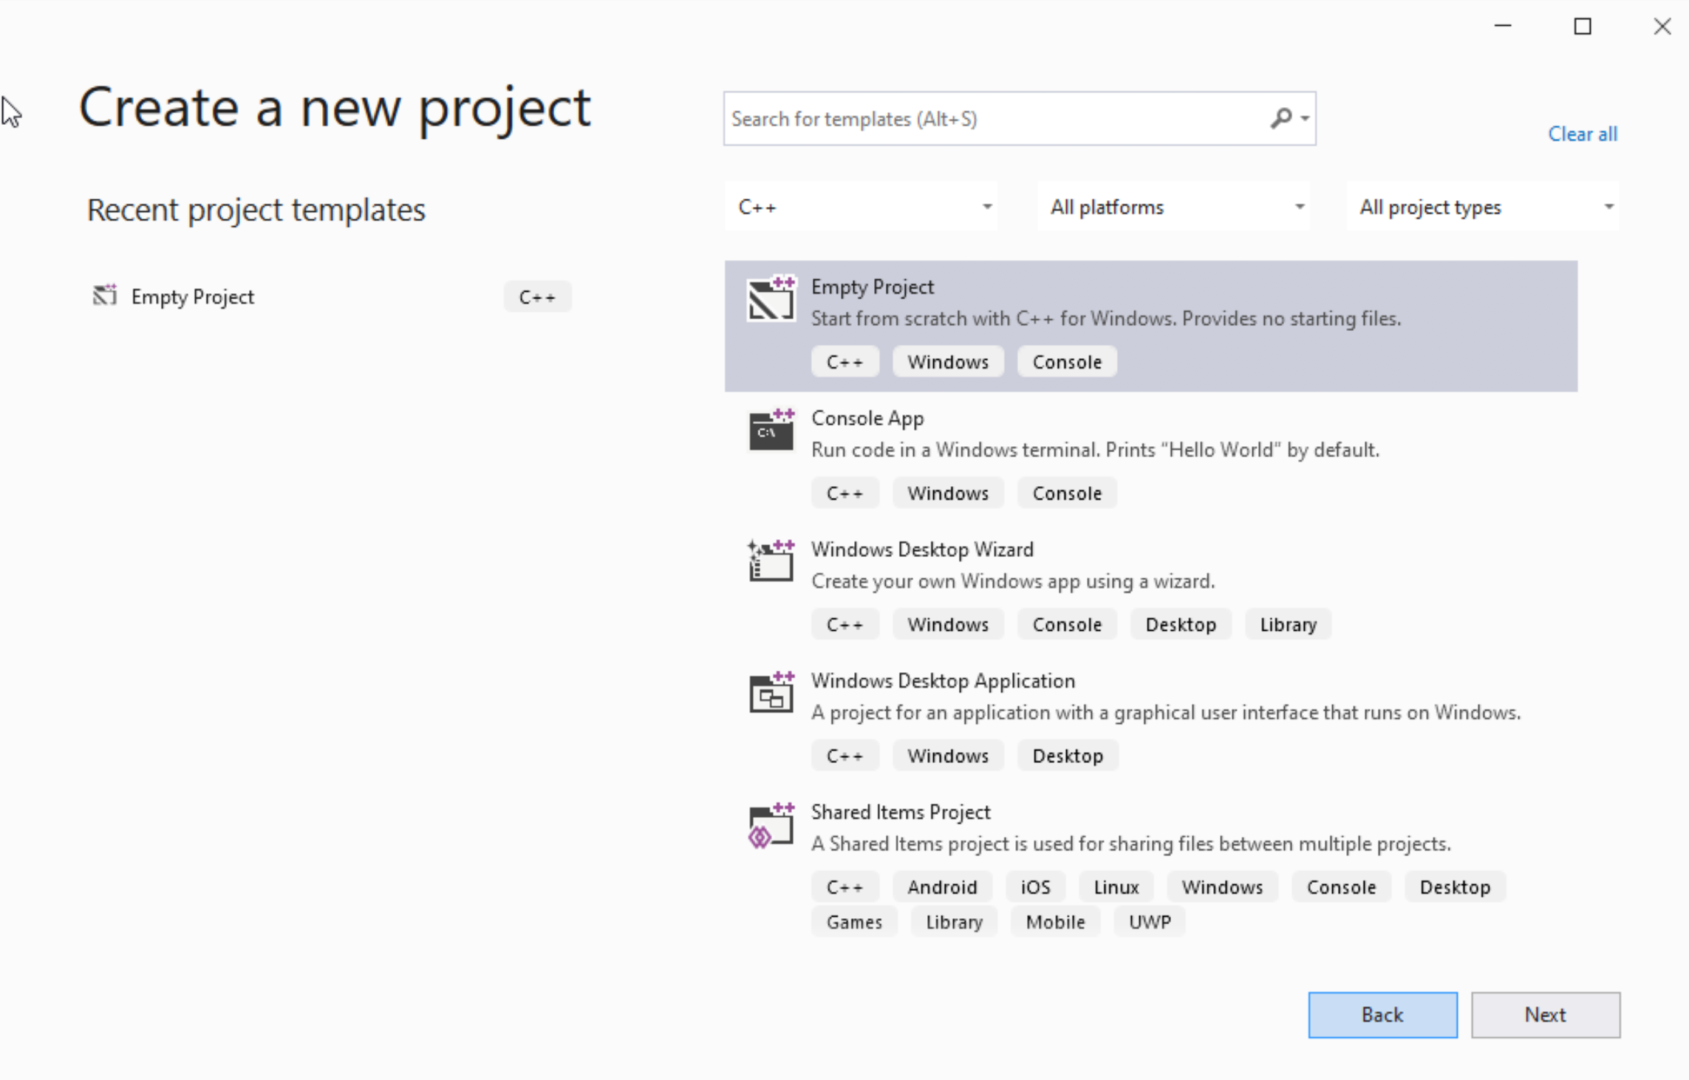




Step 1: Create a project (2)
Select C++ as language
Select Empty Project
Click Next

Slide 29
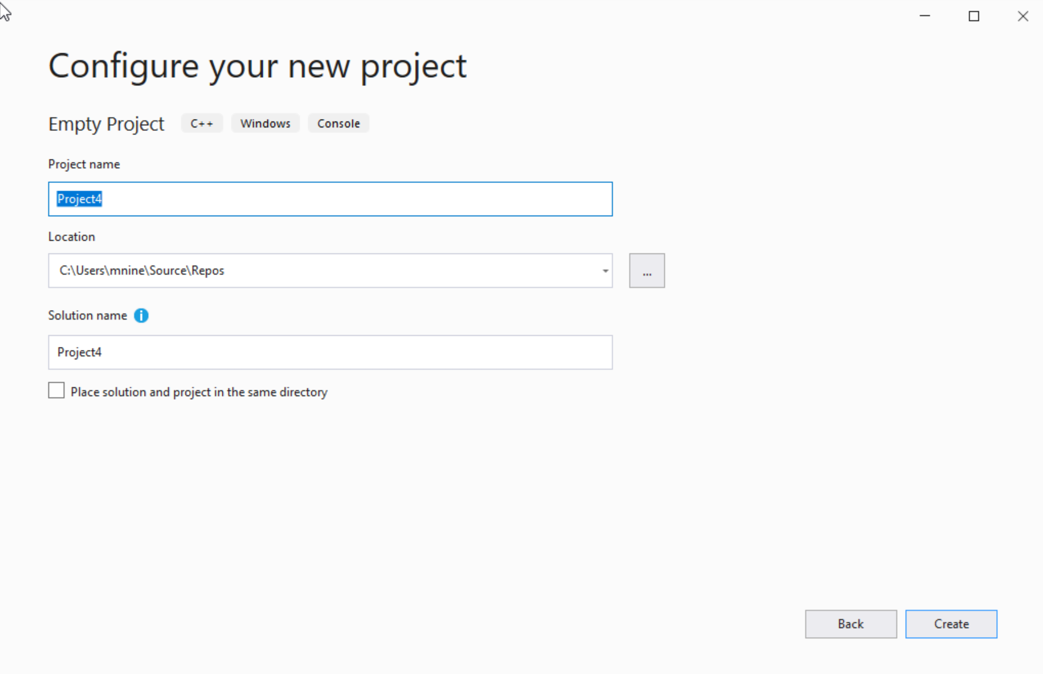

Step 1: Create a project (3)
You can change the project
name as you like
Also, you can change the
project location
Click Next

Slide 30
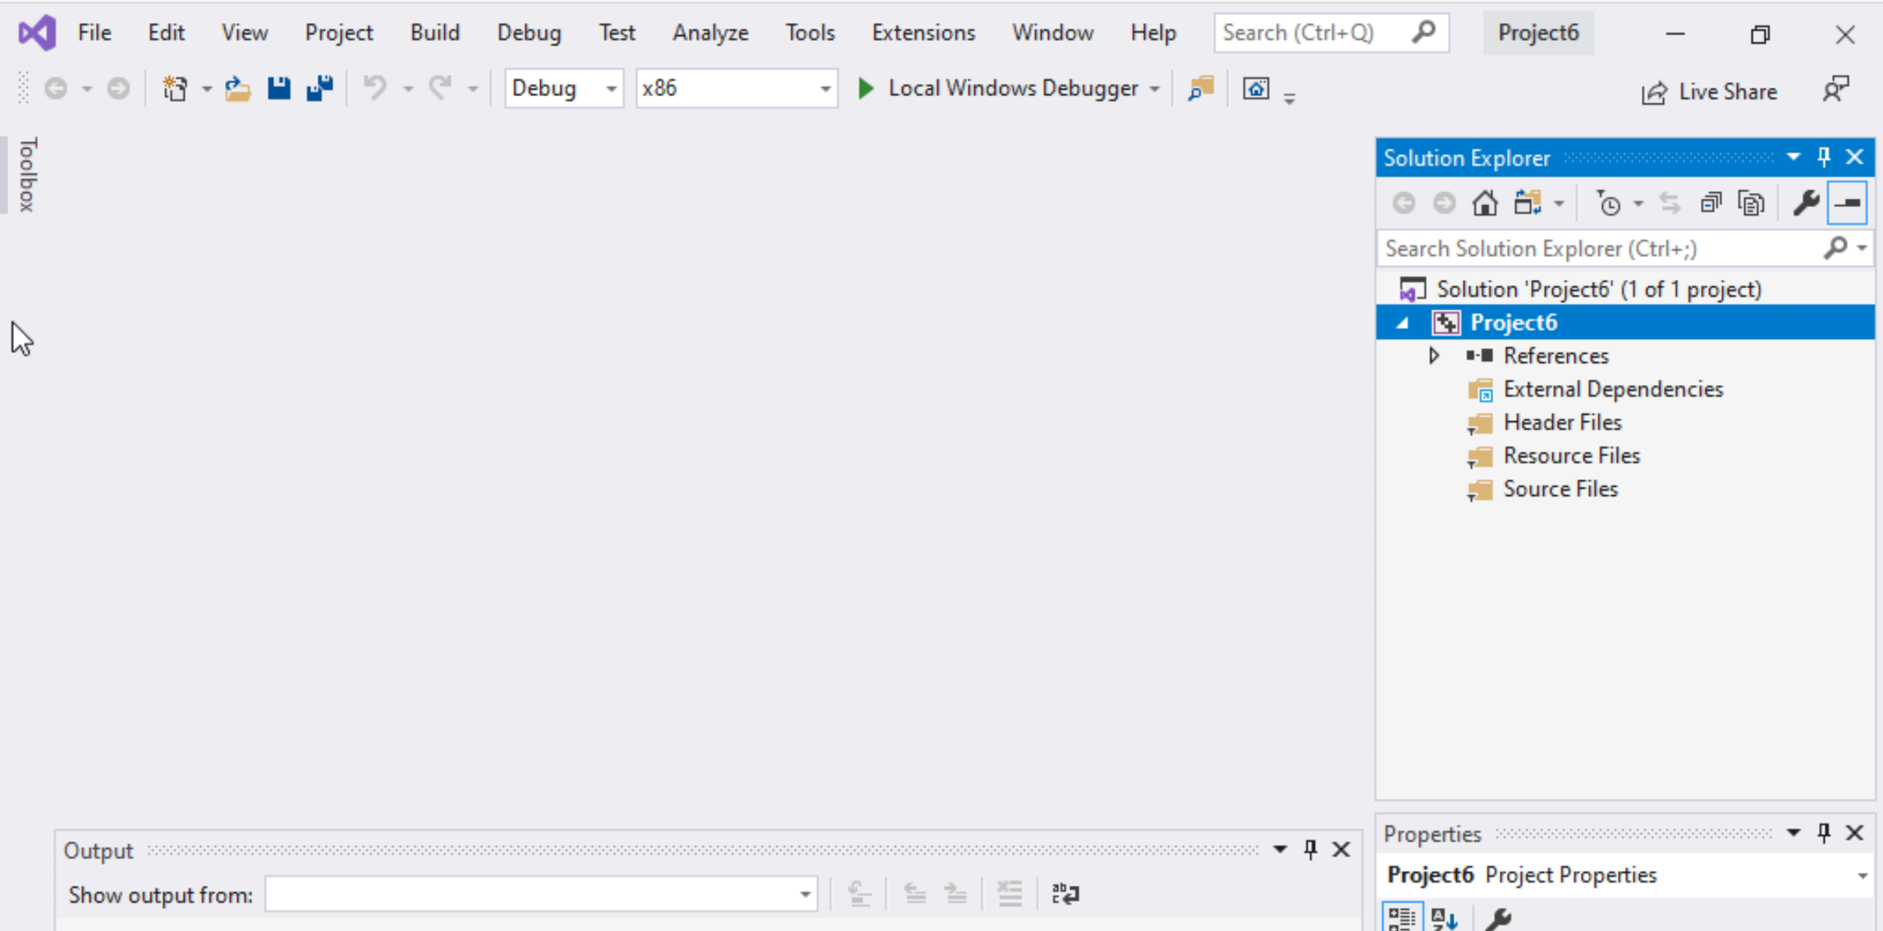
Step 1: Create a project (4)
Delete the
Following folders:
Header files
Resources Files, and
Source Files

Slide 31
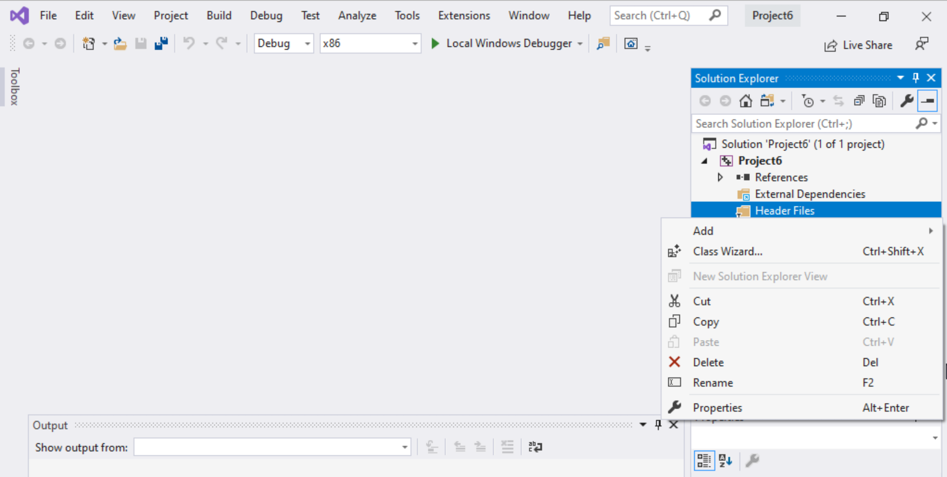
Step 1: Create a project (5)
To delete :
Select the folders
Right click on it
Select delete

Slide 32
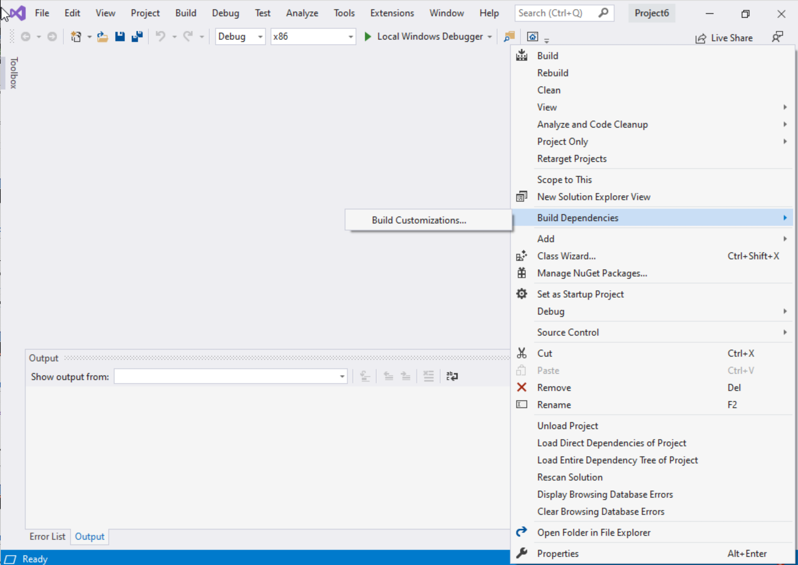
Step 1: Create a project (6)
Select Project Name on solution explorer
Right click on it
Go to Build Dependencies
Click on Build Customizations

Slide 33
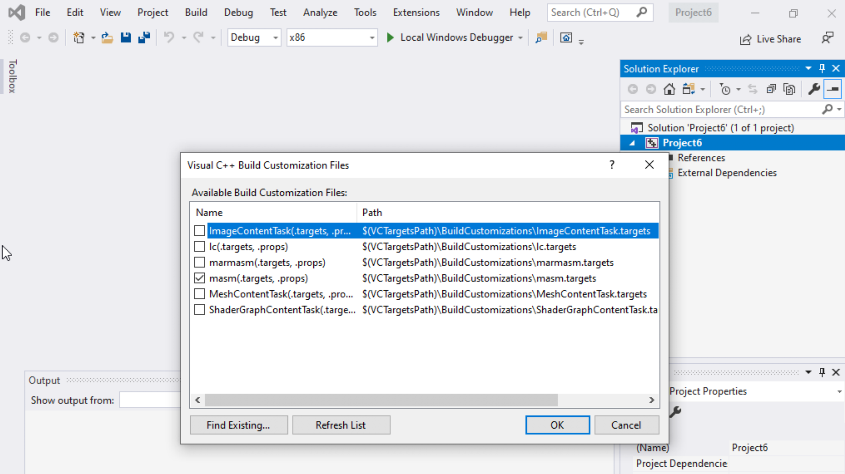
Step 1: Create a project (7)
Select masm(.target, .props)
Click ok

Slide 34
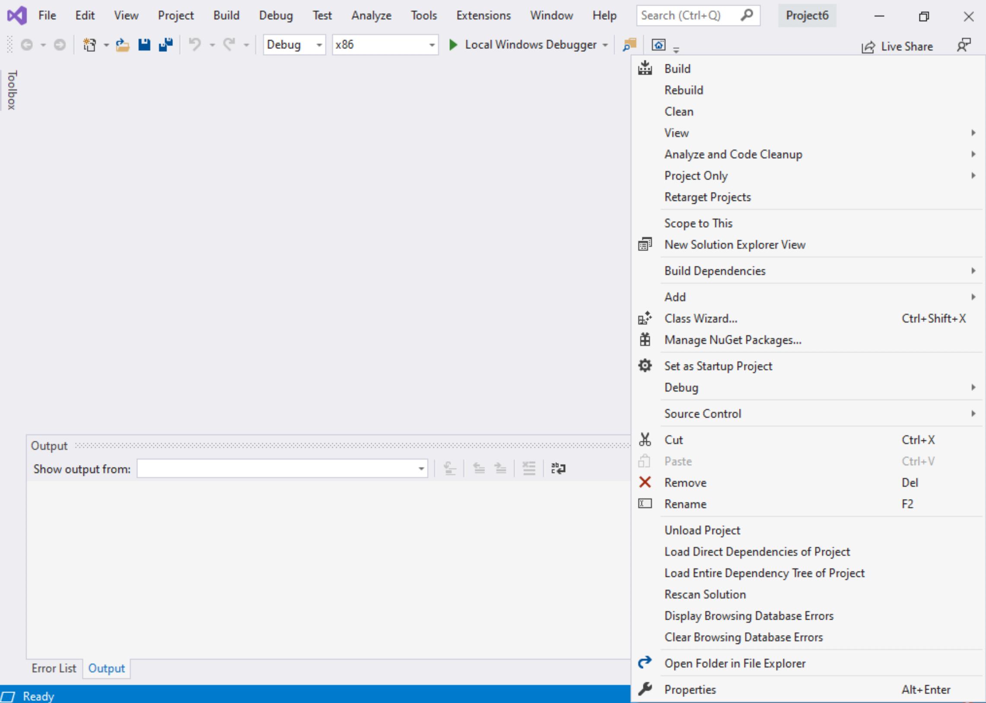
Step 1: Create a project (8)
Right click on the Project name in the solution explorer
Click properties

Slide 35
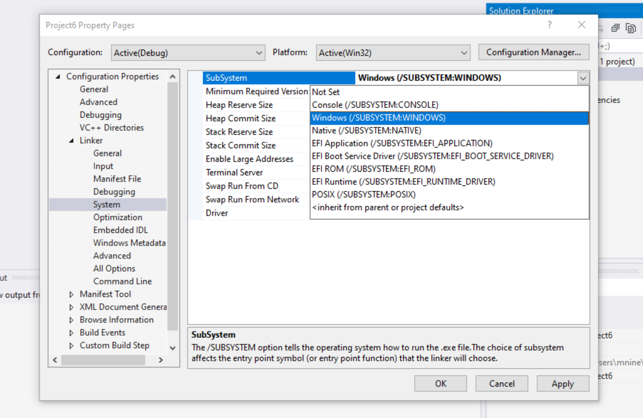

Step 1: Create a project (9)
Expand the ‘Linker’
Select ’System’
Select Windows(/SUBSYSTEM:WINDOWS)
Click OK

Slide 36
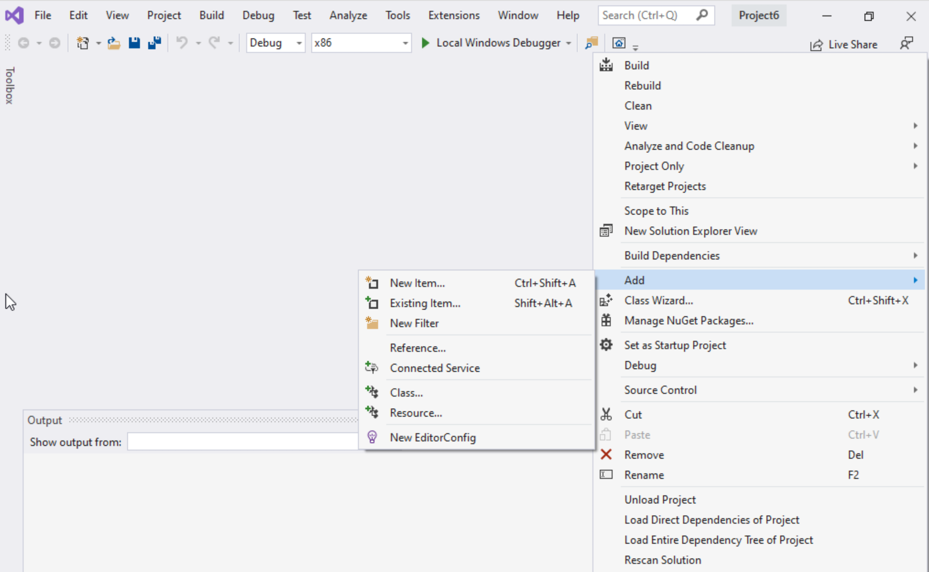
Step 1: Create a project (10)
Select Project name on solution explorer
Right click on it
Expand Add
Choose New Item

Slide 37
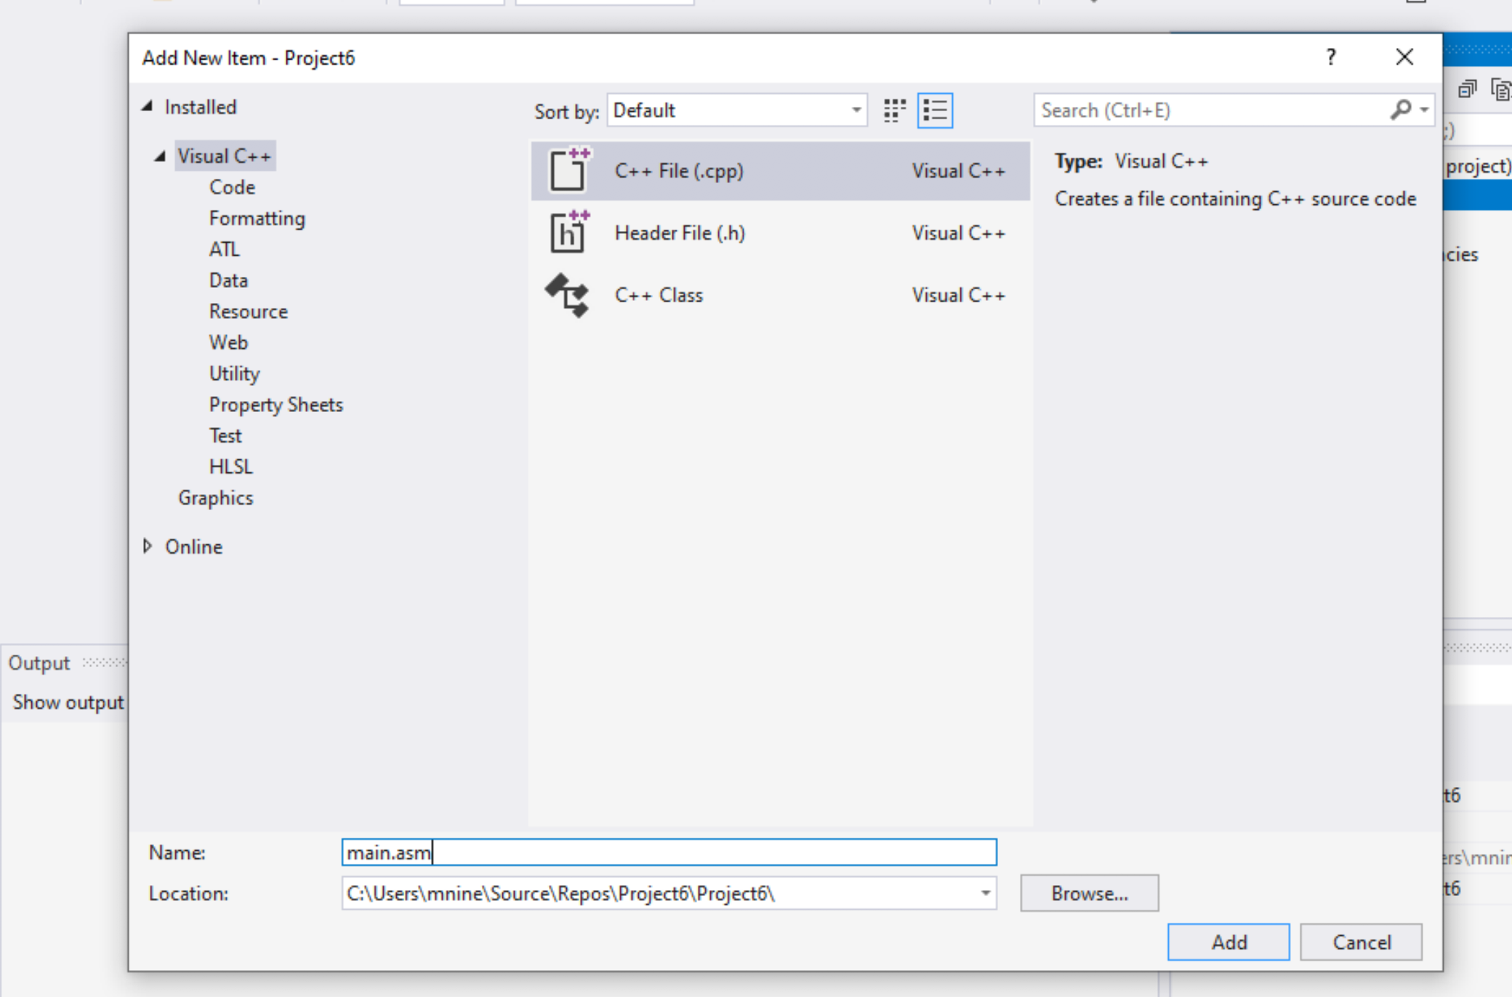


Step 1: Create a project (11)
Select C++ File(.cpp)
Name: main.asm
Click Add

Slide 38
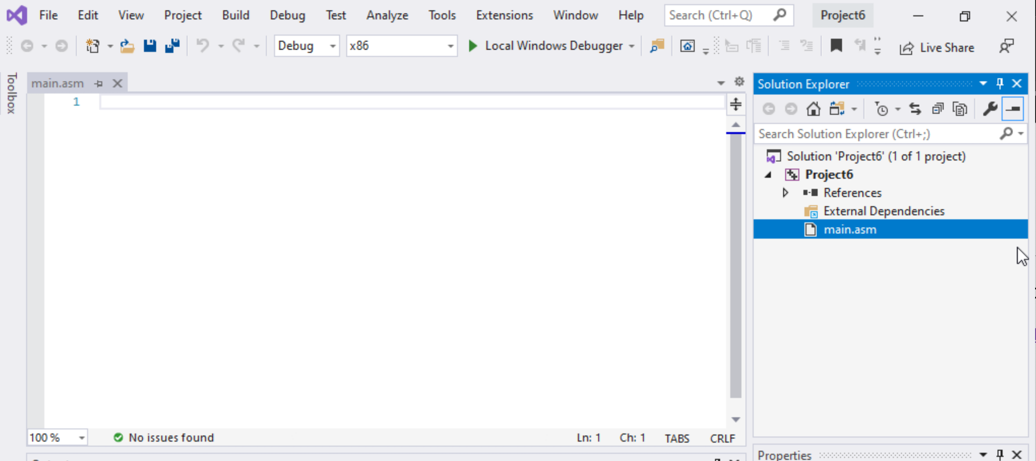

Step 1: Create a project (12)
Select main.asm
Add your code
In the main.asm File.

